Slide 1
Object Orientation with Design Patterns
Lecture 2 : Constructors - Revision

Slide 2
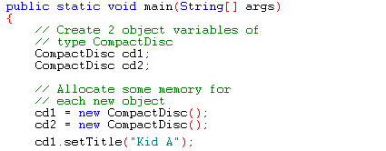
The Role of Constructors
As we have seen from previous examples classes can have set & get methods which allow the programmer to access the private data members encapsulated within the class.
In all our previous examples we created an object variable, allocated space for the object using the new operator and then called the set and get methods on the object.
Lecturer: Orla McMahon

Slide 3
The Role of Constructors
What if we wanted to use an object which when created was also initialised with some default values. So instead of creating the object and then calling its set methods all we would have to do is create it and the initialisation would happen automatically.
In order to achieve this all we have to do is write a special type of method for our class which will do the initialisation for us. These special methods are called constructors.
There are a couple of important points to remember when writing constructors.
  A constructor must have the same name as the class
  A constructor cannot have a return type declared as it is not allowed to return any values (not even void).
Lecturer: Orla McMahon

Slide 4
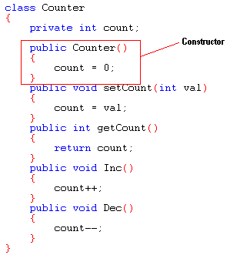
The Role of Constructors
For example if we were to write a class that modelled an integer counter we may want the internal counter variable to be initialised to zero when an object of that type was created.
Lecturer: Orla McMahon

Slide 5
The Role of Constructors
If we were to create an object of type Counter the constructor would be called automatically and the internal data member, count, would be initialised to zero.
So constructors are not explicitly called. If a class has a constructor method it will be called automatically once the new operator has allocated memory for the object.
  Counter c1;
  c1 = new Counter(); // Constructor gets called here
So if a class has a constructor method you can be guaranteed that it will be the first method to be called on the object. The next slide shows a test program for the counter class.
Lecturer: Orla McMahon

Slide 6
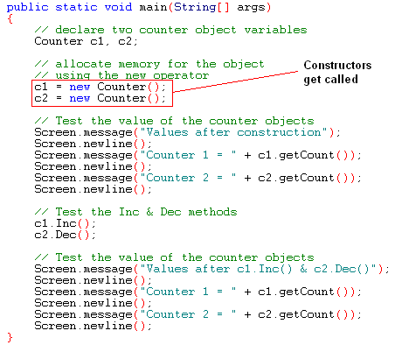
The Role of Constructors
Lecturer: Orla McMahon

Slide 7
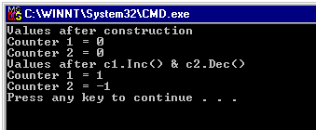
The Role of Constructors
If we examine the output of the counter test program we can see that the two counter objects are initialised to zero as soon as the new operator is executed.
Lecturer: Orla McMahon

Slide 8
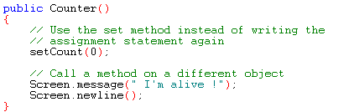
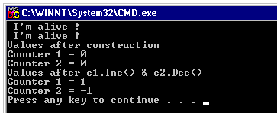
The Role of Constructors
As well as initialising internal data members we can also call other methods from within a constructor.
Lecturer: Orla McMahon

Slide 9
The Role of Constructors
The constructors we have looked at so far are known as default constructors. They are called default constructors because they do not take any parameters.
There is however another type of constructor, one which does take parameters. This type of constructor is called a user defined constructor.
So for example we could have written a constructor for the counter class which took as its parameter an integer value which could be used to initialise the count data member.
This means we would no longer have to hard code the initial value in the constructor code because the programmer could pass a value in to the constructor during the call to new.
Lecturer: Orla McMahon

Slide 10
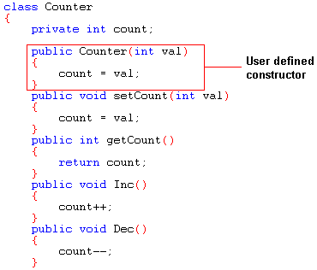
The Role of Constructors
The following code shows the counter class with a user defined constructor that takes as its input an integer value.
Lecturer: Orla McMahon

Slide 11
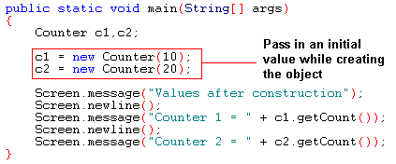
The Role of Constructors
We can test the new user defined constructor with the following code.
Lecturer: Orla McMahon

Slide 12
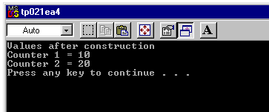
The Role of Constructors
When the test program is executed we get the following output.
Lecturer: Orla McMahon

Slide 13

Summary
We have seen how constructors are used to initialise an objects data members, either by using a default constructor where the values are hard coded or by using a user defined constructor where values can be passed.
Lecturer: Orla McMahon

